Slide 1

The Firm and its customers
Unit 7.1-7.6

Slide 2
The Firm’s Decisions
We observe that firm’s use different pricing and output strategies.
Firms also make decisions on advertising, innovation
We focus on the price and output decisions first.
The goal is to identify the profit-maximising decisions
Firms have to make many decisions

Slide 3
7.1 Choosing a Price
The Breakfast Cereal Case

Slide 4
Introduction
This section introduces two analytical tools to explain the pricing and output decision.
These are
The Demand Curve
The Isoprofit Curve
These are for firm selling differentiated product

Slide 5
What are differentiated products?
A differentiated product is similar to those sold by rival firms but
  Has some unique characteristics or points of difference with others.
Examples:
  Mobile phones
  Different varieties of beer
  Coffee
  Cameras
Differentiated products are commonly encountered by consumers

Slide 6
All combinations of a price and output that generates the same level of profit
Isoprofit curve

Slide 7
The IsoProfit Curve
Profit = Total Revenue – Total Cost
= TR - TC
= PQ – (unit-cost)Q
Assuming the costs are a constant unit.
The Isoprofit Curve shows all the combinations of price and quantity sold that produces the same profit.

Slide 8
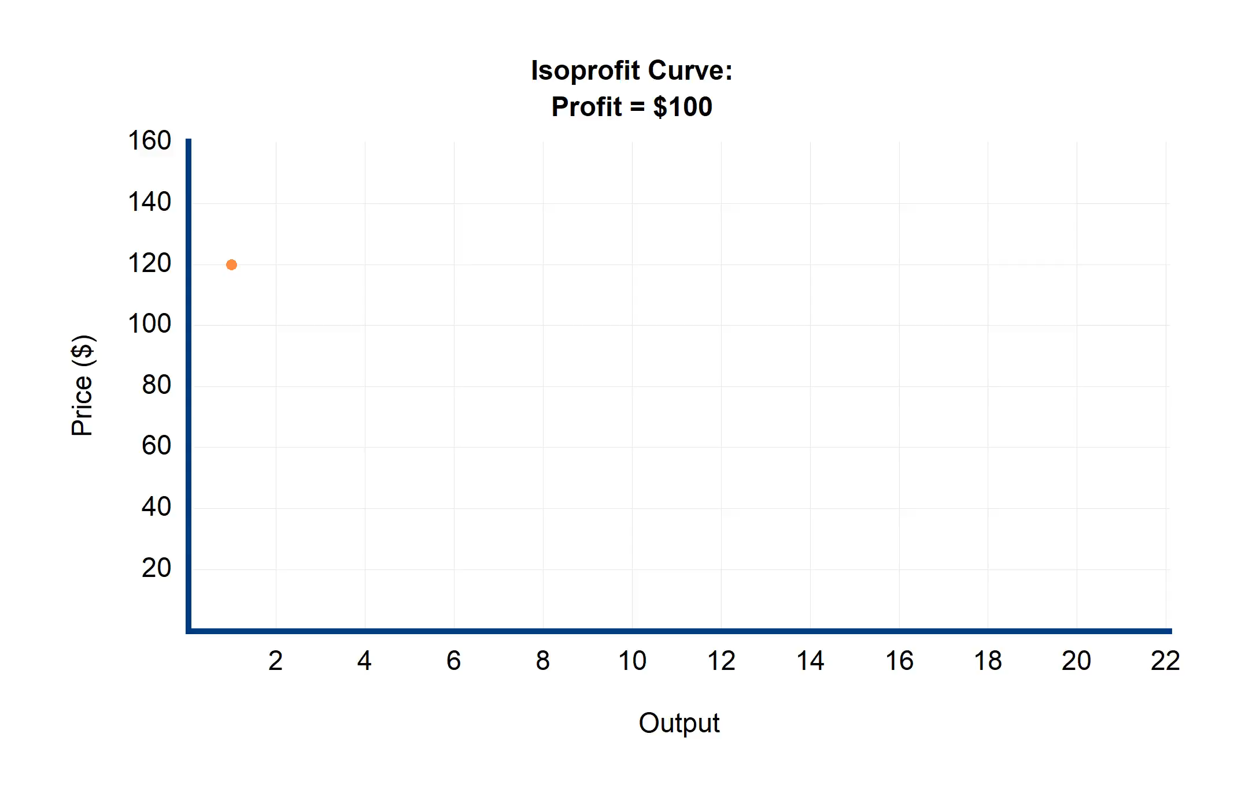
Isoprofit Curve
Shows all price-output combinations that produce the same profit.
This example assumes constant average costs.

Slide 9
Data
Price ($) | Quantity | Total Revenue | Total Cost
120 | 1 | 120 | 20
70 | 2 | 140 | 40
53.33 | 3 | 160 | 60
45 | 4 | 180 | 80
40 … | 5 … | 200 … | 100 …
Table illustrates graph above.

Slide 10
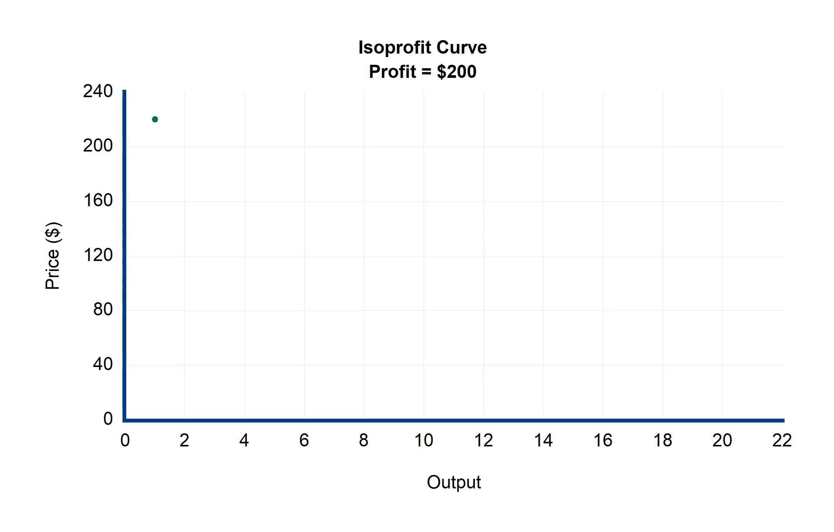
Isoprofit Curve
Shows Isoprofit curve for same firm.
Now profit is fixed at $200

Slide 11
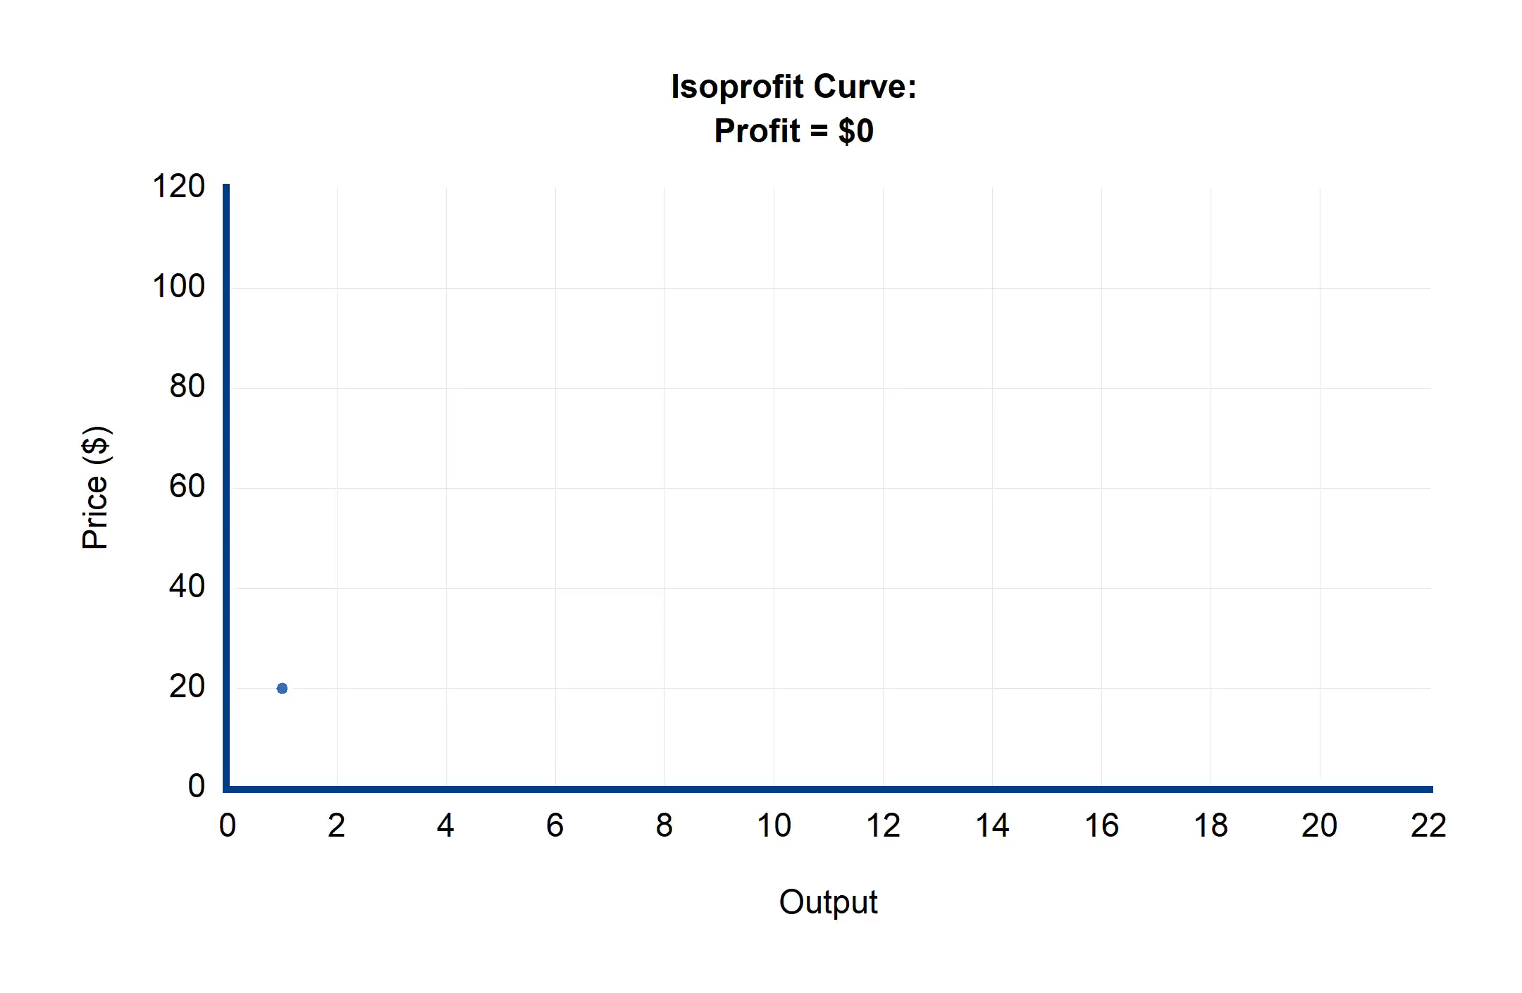
Isoprofit Curve
Shows Isoprofit curve for same firm.
Now profit is fixed at 0
This means the price must equal the average cost of production.

Slide 12
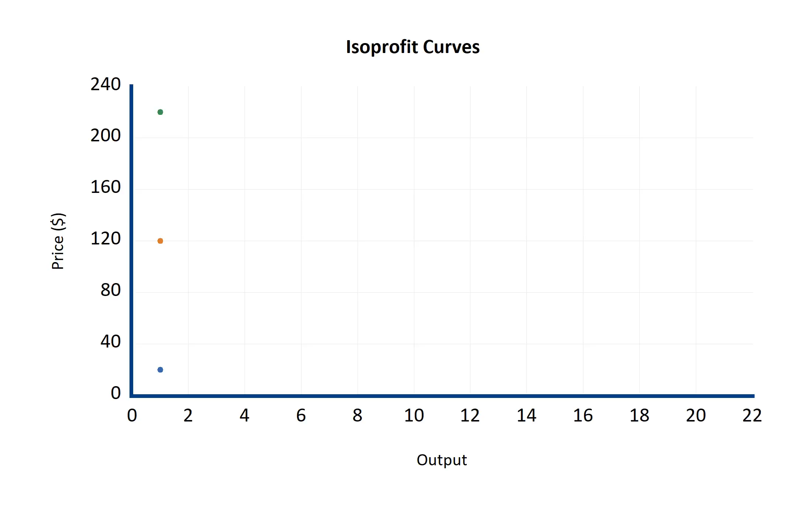
Isoprofit Curve
Shows all 3 curves.
The higher the profit, the higher the Isoprofit Curve must be.

Slide 13
Summary
The isoprofit curve shows that firms can achieve the same profit goal by producing:
  A small output for a high-price markup, or
  A large output for a low-price markup, or
  Some combination between this.

Slide 14
Isoprofit Curve
Textbook Example

Slide 15
Cheerios
The economist Hausman estimated the demand curve for cheerios using sales data.
Analysing sales data is one way economists estimate demand functions.
Another way is to use surveys.
  Surveys are sometimes the only way to estimate demand.
  E.g. new products, non-market goods, black-market goods.
Cheerios are a popular US breakfast cereal.

Slide 16
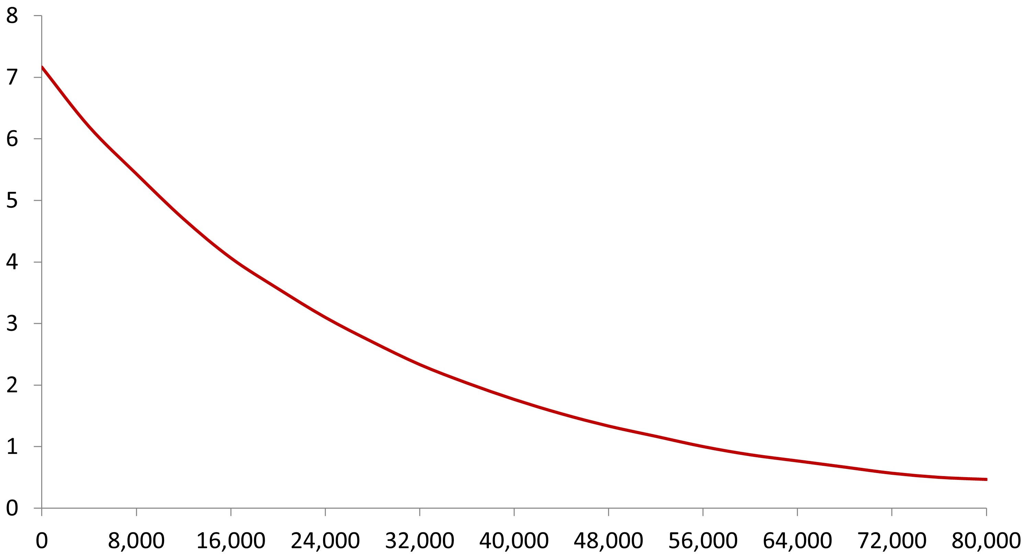
Estimated Demand Curve

Slide 17
The firm’s problem
The firm now has two problems:
  What price do they charge for Cheerios?
  What quantity of this cereal should they produce?

Slide 18
Example
Given a unit cost of $2 per pound, the firm could make a profit of $60,000 by
Selling 60,000 units for $3 or
20,000 units for $5 or
10,000 units for $8

Slide 19
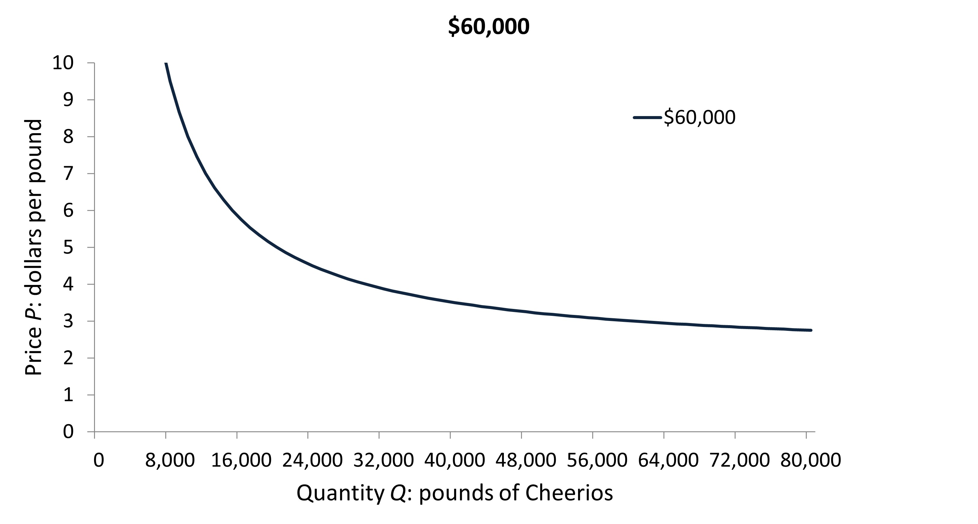
The Isoprofit Curve for $60,000

Slide 20
Mapping the Isoprofit Curves
Isoprofit curves at different profit levels can be stacked on the same graph.
Note that each curve represents a price-quantity pair that produces the same profit.

Slide 21
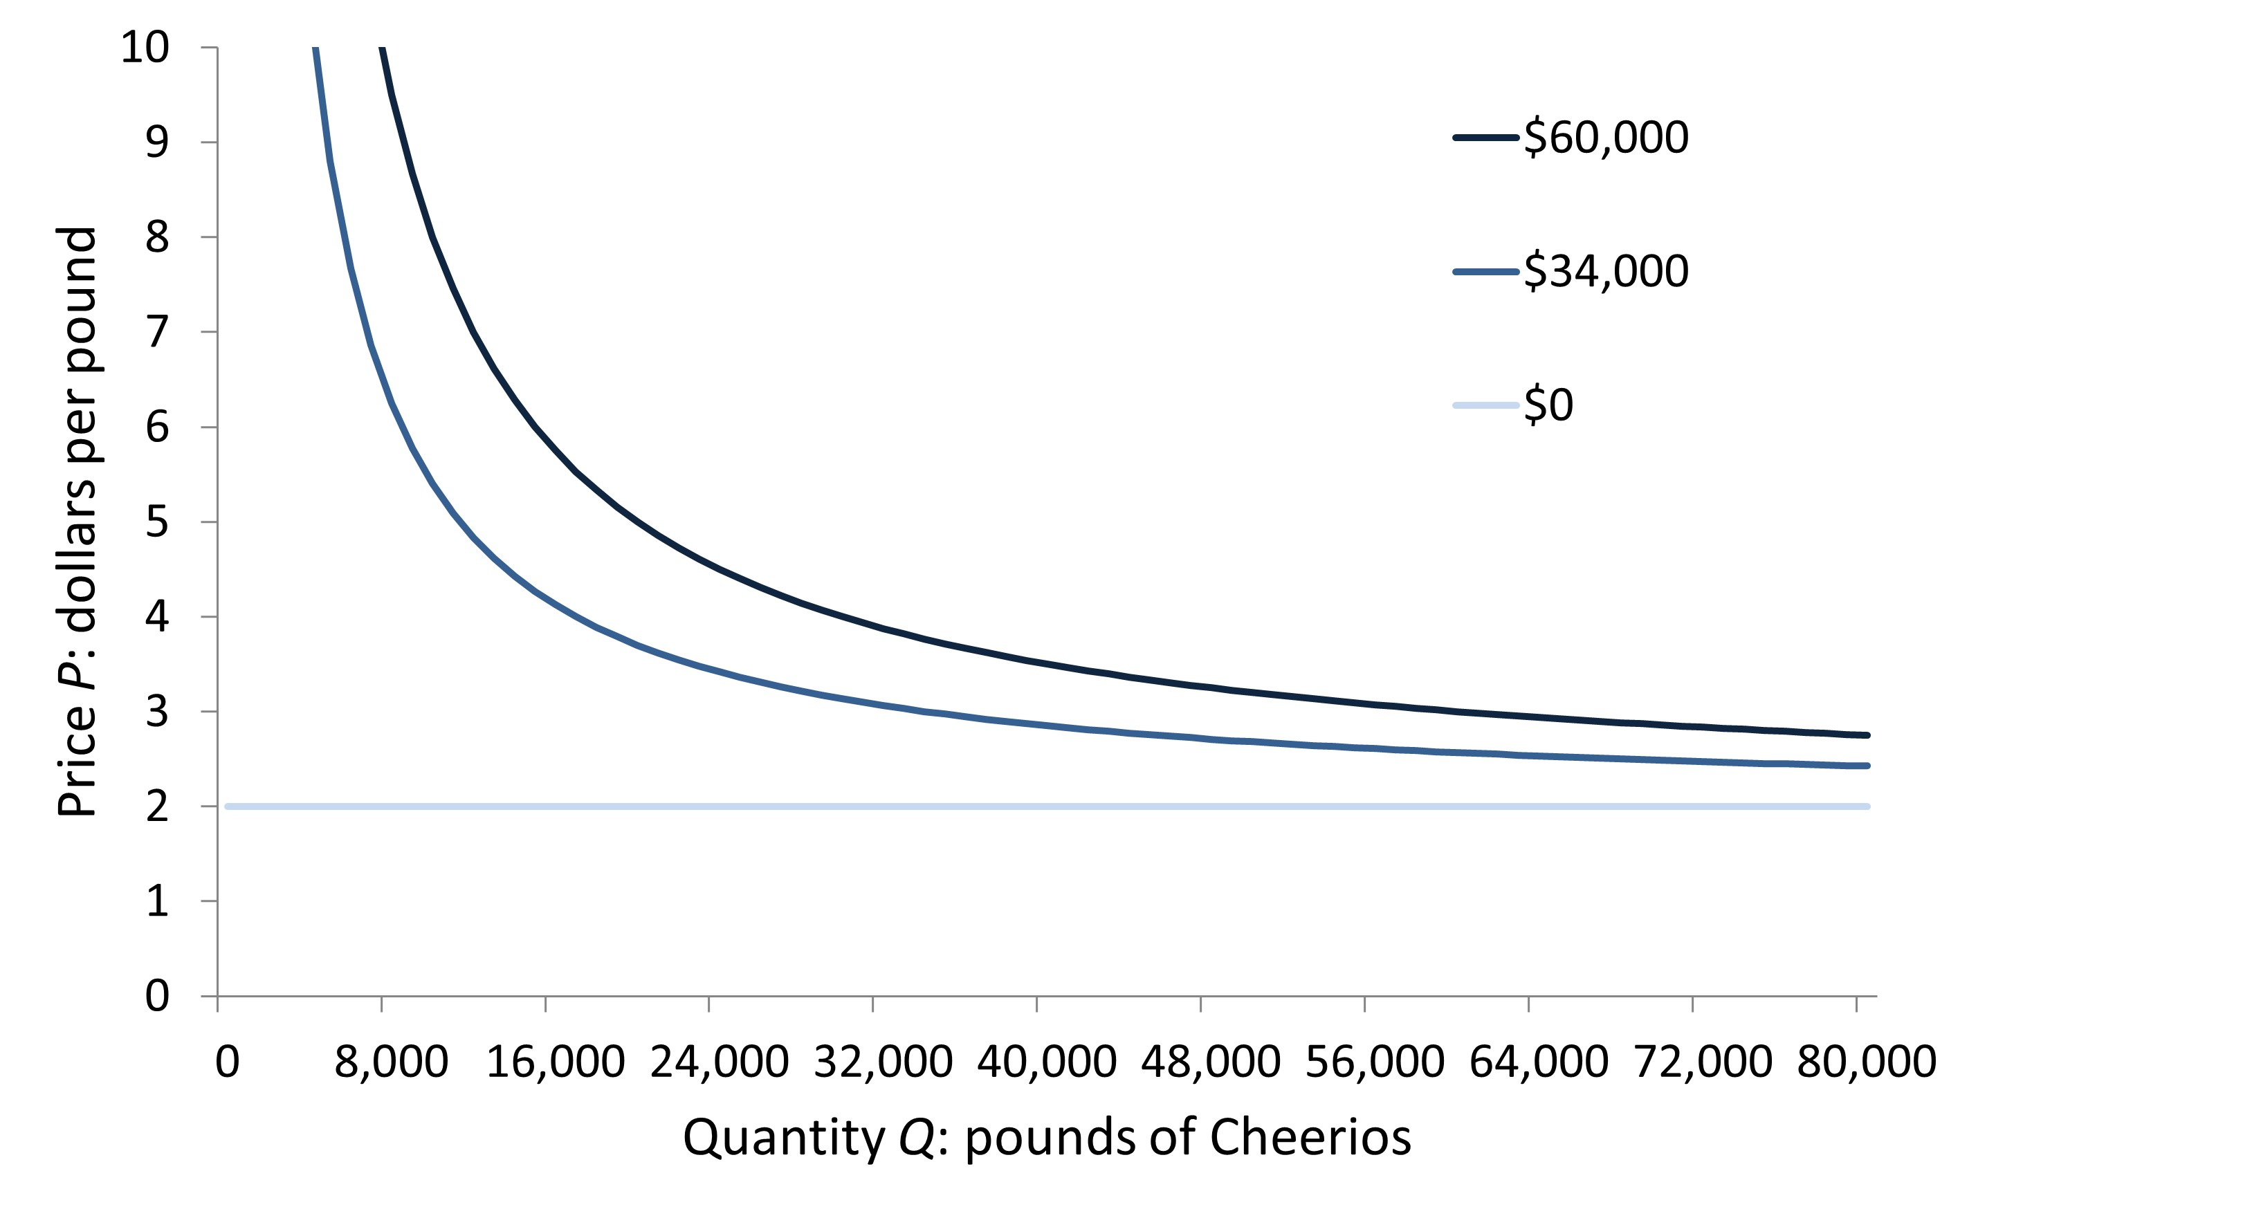
Stacked Isoprofit Curves

Slide 22
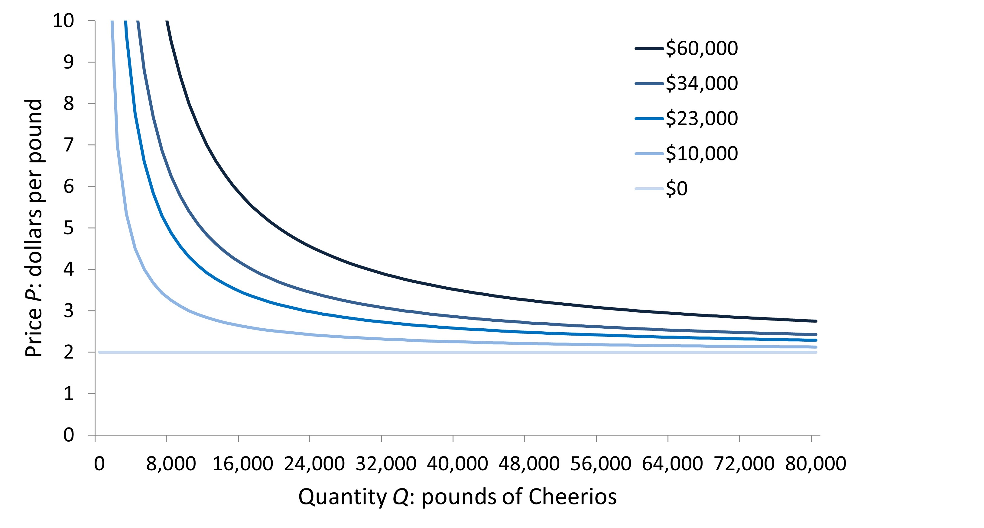
Stacked Isoprofit Curves

Slide 23
The Profit-Maximising Choice
The firm increases its profits at a high price-quantity pair.
The firm’s choice is limited by the demand curve
The best decision is to find a price-quantity output tangential to the demand curve

Slide 24
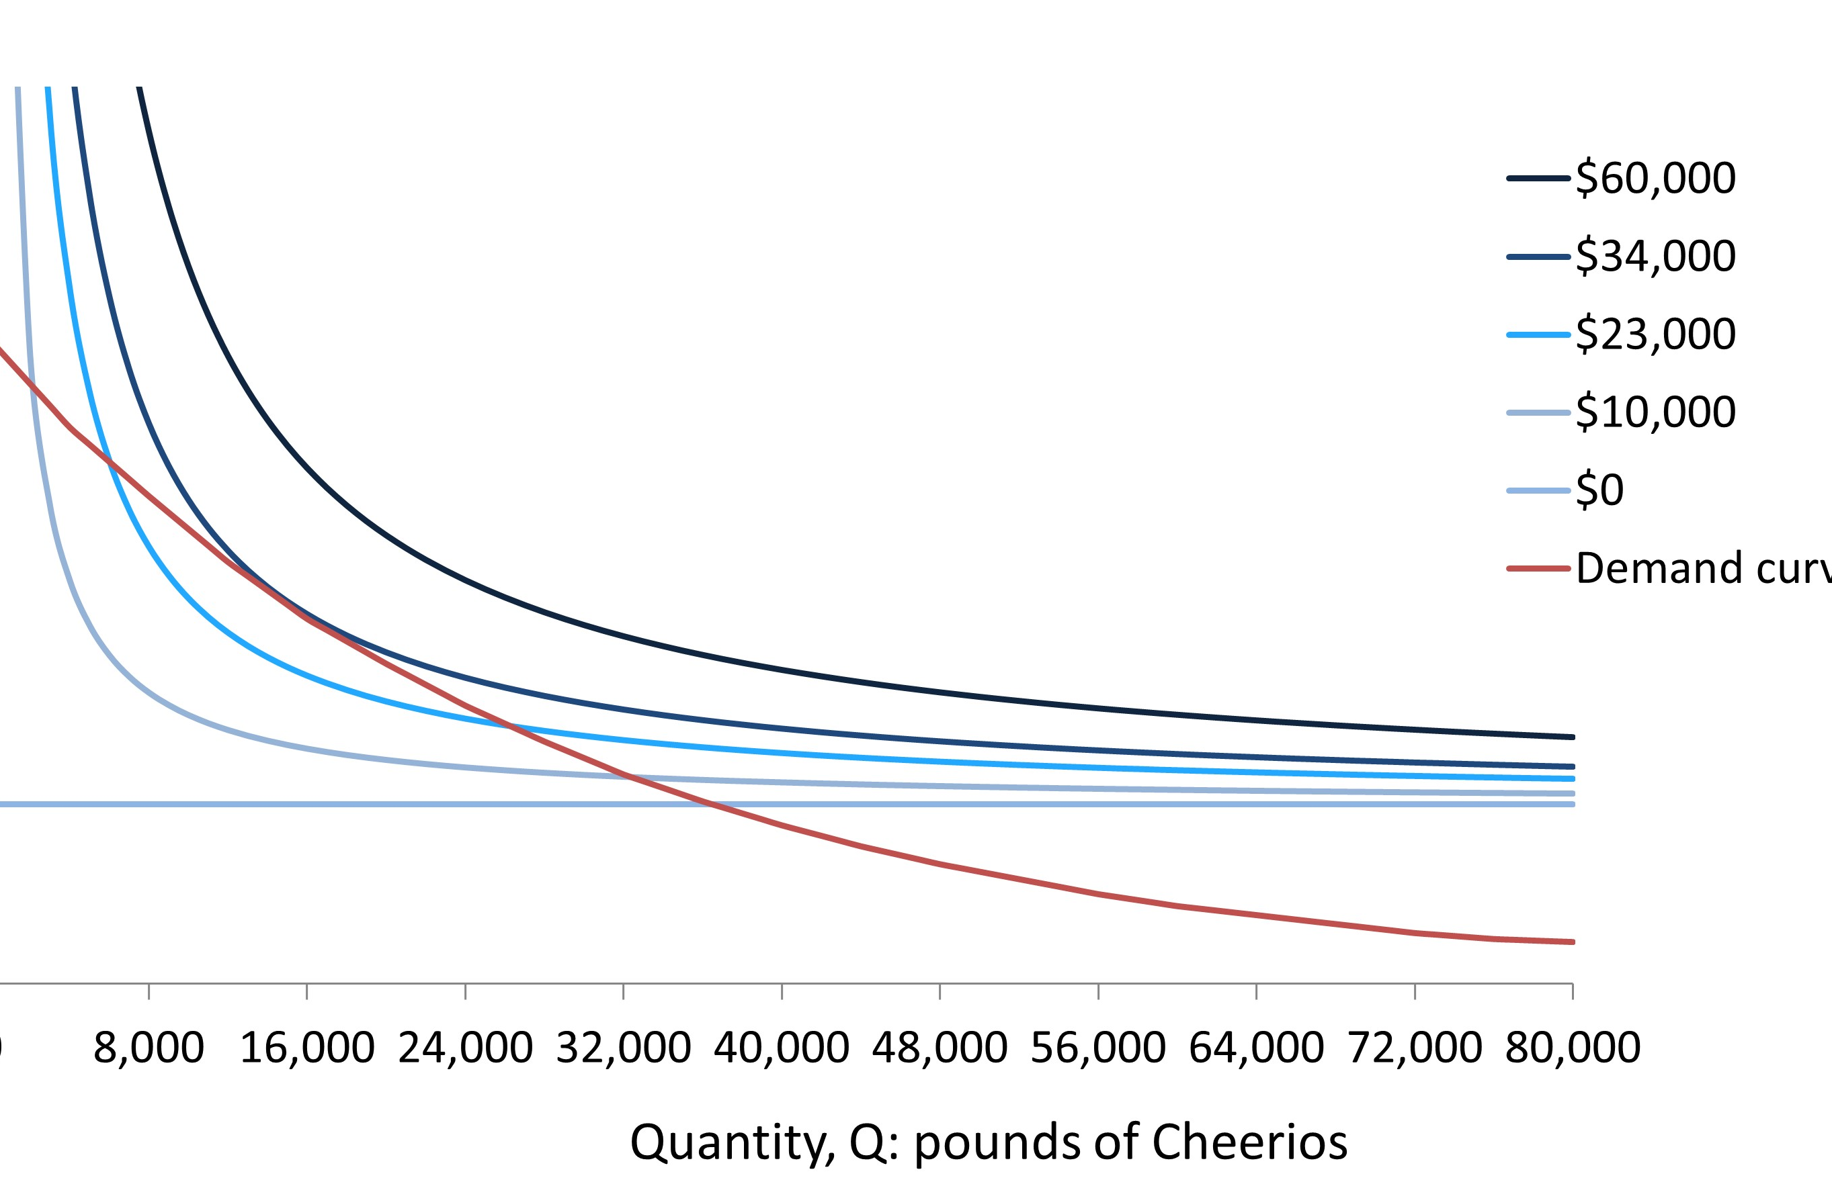
Combining the isoprofit curve with demand
Only the area along and under the demand curve are feasible price-quantity pairs.

Slide 25
Profit-Maximisation
Only the point where the demand curve is tangent to the isoprofit curve will maximise profits

Slide 26
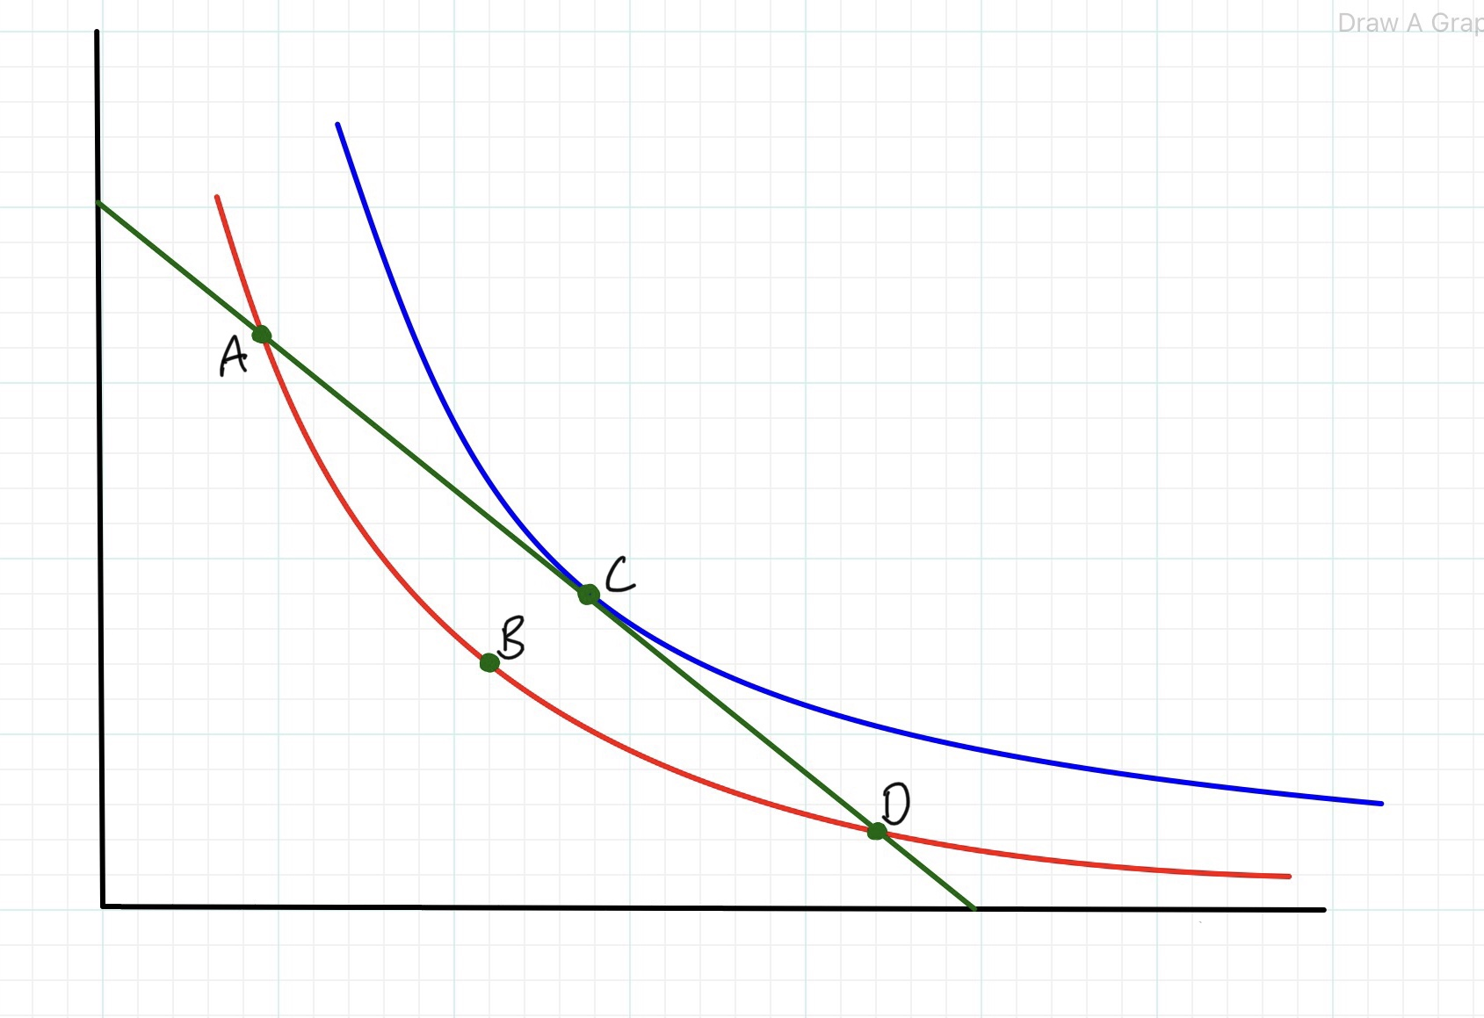
Profit Maximisation
$
At Point A the firm should:
  Reduce the price of their product
  Increase the output of their product and;
Increase profit from Isoprofit 1
Isoprofit 2
Demand
Isoprofit 1
Quantity

Slide 27
Profit Maximisation
$
At Point B the firm should:
  Increase the price of their product
  Increase the output of their product and;
Increase profit from Isoprofit 1
Isoprofit 2
Demand
Isoprofit 1
Quantity

Slide 28
Profit Maximisation
$
At Point D the firm should:
  Increase the price of their product
  Decrease the output of their product and;
Increase profit from Isoprofit 1
Isoprofit 2
Demand
Isoprofit 1
Quantity

Slide 29
Profit Maximisation
$
At Point C (tangency) it is impossible to increase profit by a different price-output combination.
Isoprofit 2
Demand
Isoprofit 1
Quantity

Slide 30
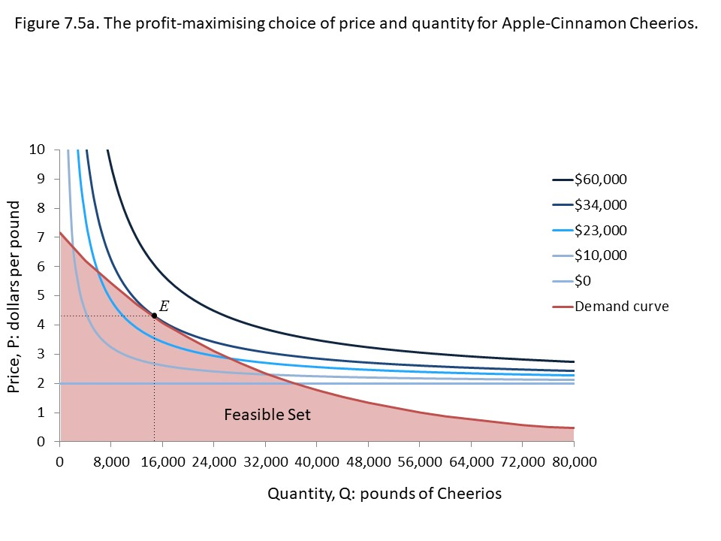
Figure 7.5a
If the firm’s price-quantity decision is under the demand curve, it can increase profits by increases prices and quantities.
If it is on the demand curve, but not at the tangency, it can increase profit by moving to highest isoprofit curve

Slide 31
Depicting the profit curve
We can plot the profit for each quantity level, using the isoprofit curve that crosses, or is tangent to, the demand curve.
By matching this demand curve to the profit curve, you can see profit is maximised at tangency

Slide 32
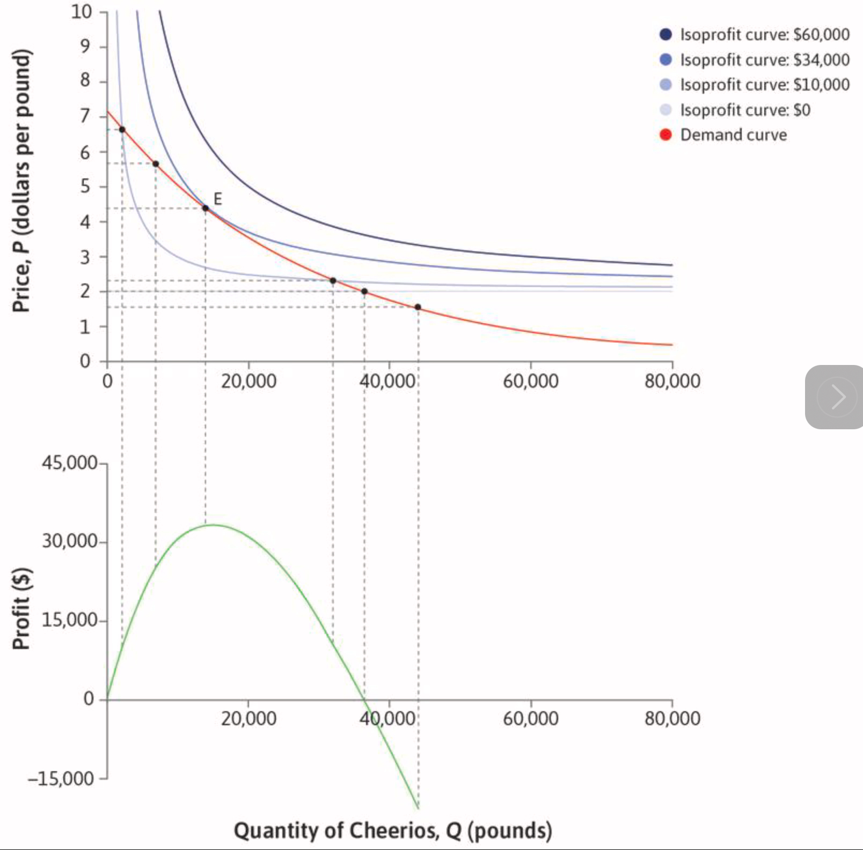
Profit Curve

Slide 33
Question 7.3
Q | 100 | 200 | 300 | 400 | 500 | 600 | 700 | 800 | 900 | 1000
P | 270 | 240 | 210 | 180 | 150 | 120 | 90 | 60 | 30 | 0
The firm’s unit cost of production is $60. Based on this information, which of the following is correct?
Question a
At Q = 100, the firm’s profit is $20,000

Slide 34
Question 7.3
Q | 100 | 200 | 300 | 400 | 500 | 600 | 700 | 800 | 900 | 1000
P | 270 | 240 | 210 | 180 | 150 | 120 | 90 | 60 | 30 | 0
The firm’s unit cost of production is $60. Based on this information, which of the following is correct?
Question b
The profit-maximizing output is Q = 400

Slide 35
Question 7.3
Q | 100 | 200 | 300 | 400 | 500 | 600 | 700 | 800 | 900 | 1000
P | 270 | 240 | 210 | 180 | 150 | 120 | 90 | 60 | 30 | 0
The firm’s unit cost of production is $60. Based on this information, which of the following is correct?
Question c
The maximum profit that can be attained is $50,000

Slide 36
Question 7.3
Q | 100 | 200 | 300 | 400 | 500 | 600 | 700 | 800 | 900 | 1000
P | 270 | 240 | 210 | 180 | 150 | 120 | 90 | 60 | 30 | 0
The firm’s unit cost of production is $60. Based on this information, which of the following is correct?
Question d
The firm will make a loss at all outputs of 800 and above.

Slide 37
7.2 Economies of Scale
02.
Cost Advantages of large-scale production

Slide 38
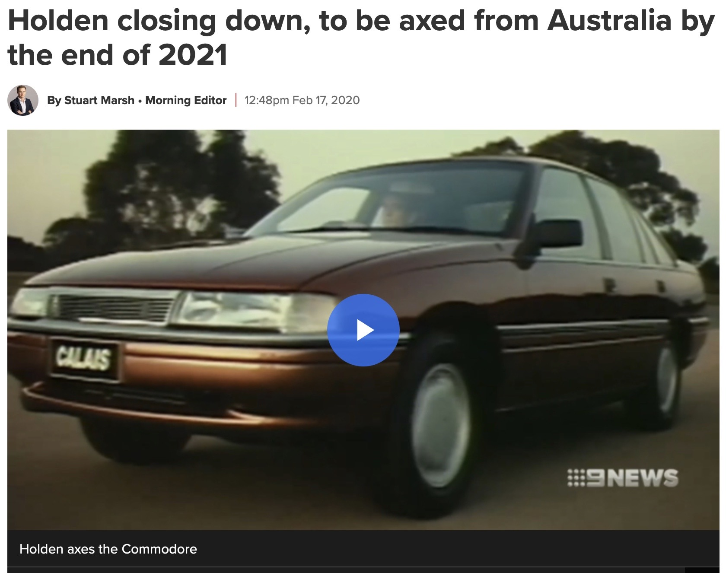
Example
Holden in Australia closed car production.
Production costs roughly twice as high as Europe, four times as Asia.
Produced cars for the Australian and NZ markets.

Slide 39
Holden
In 2016 Australia produced 161,294 cars
In 2022 Thailand produced 1,883,515 and
Japan produced 7,835,519 cars.
Australian production costs were substantially higher than other major car manufacturers.
Car manufacturing exhibits economies of scale.
Australia and NZ markets use right-hand drive cars.
In both countries motorists drive on the left hand side of the road.
Most countries use left-hand drive cars and drive on the right.

Slide 40
Costs
Two Reasons
Technological advantages
Use fewer inputs per unit of output
Cost advantages
Fixed costs have smaller impacts
Large firm has more bargaining power
Large Firms may have lower costs per unit

Slide 41
Cost Advantages
Some costs a firm experiences are fixed costs
  Example: Research and Development, Marketing Expenses.
The larger the output, the smaller the average fixed cost becomes.
Large firms may be able to purchase inputs on more favourable terms.

Slide 42
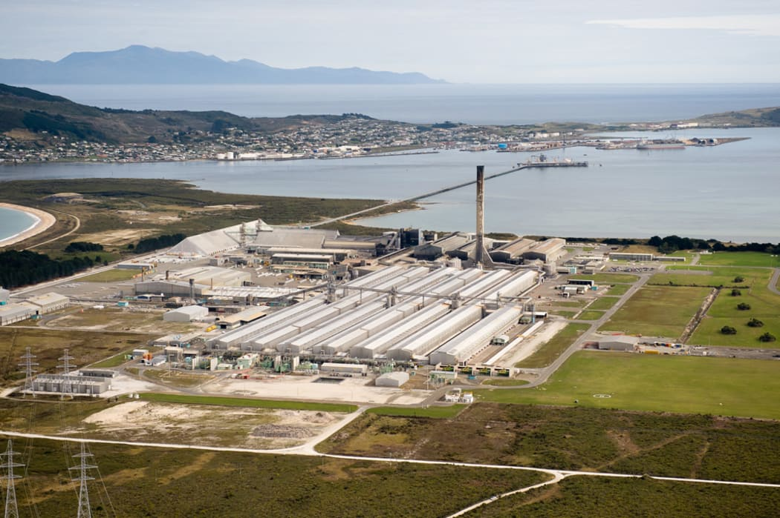
NZ Aluminium Smelter
The smelter at Tiwai uses approximately 12% of NZ’s total electricity demand.
It is able to negotiate lower electricity prices, based on its size.

Slide 43
Three types of scale effects
Economies of Scale
Proportionate increase in output is
greater than increase in inputs
Diseconomies of Scale
Proportionate increase in output is
Constant Returns to Scale
Proportionate increase in output is
less than increase in inputs
equal to the increase in inputs
Also Increasing returns to scale
Also Decreasing returns to scale

Slide 44
Sources of Scale Economies
Diseconomies- coordination and management problems with large firms.
Economies- Demand Advantages
Network economies of scale
E.g. standardised software, bicycle wheels

Slide 45
7.3 Production
03.
Cost Functions

Slide 46
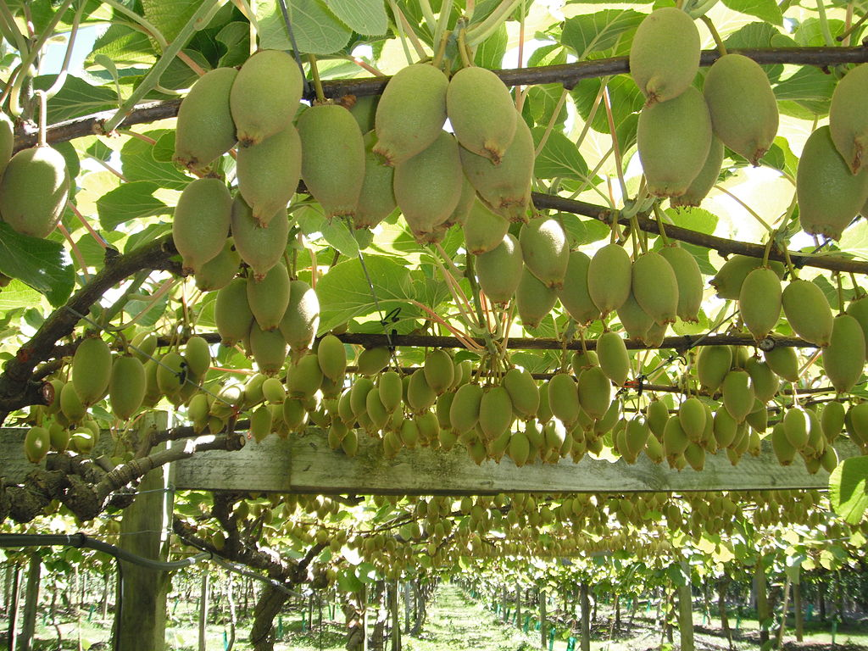
Introduction to Costs
Costs include all the opportunity costs of the inputs.
This includes the firm’s owners.
E.g. Some dairy farms in Northland have been converted to avocados. Land has an opportunity cost. Dairying did not earn enough for the firm’s owners to continue.

Slide 47
Costs
All the firm’s costs are divided into fixed and variable.
Fixed Costs always have to be paid, whether the firm produces nothing or a lot.
Variable costs are the costs of making each unit.

Slide 48
NZ Plantation Forestry
Age/Time | Silvicultural Costs $/ha | Overhead costs $/ha per year | Clearfell Revenue
1-28 |  | 100
0 | 1,000
1 | 40
5 | 450
6 | 450
8 | 450
10 | 400
28 |  |  | 70,000
Table depicts typical cost of producing Pinus radiata logs
Overhead costs are the fixed costs.
Silvicultural costs include thinning and pruning.

Slide 49
Average and Marginal Costs
Dividing the costs by the quanity (q) generates the average costs.
The change in total cost generated by changing output by 1 unit, is the marginal cost.

Slide 50
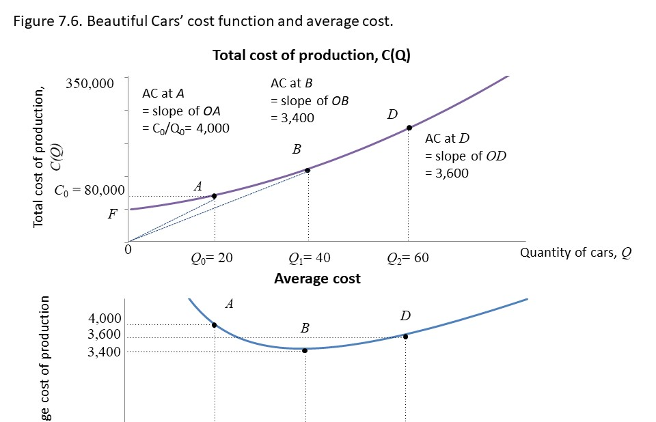
Depicting the Cost Curves

Slide 51
Costs
At point A:
  20 cars are produced
  Total Cost is $80,000
  The Average Cost is $80,000/20 = $4000
As output increases above A, fixed costs are shared between more cars.
At Point B:
  40 cars are produced
  Total Cost is $136,000
  Average Cost is $3400
The more cars that are produced, the higher the total costs will be.
AC = TC/Q
F is the firm’s fixed costs

Slide 52
Costs
At Point B, average cost is lowest.
As output increases above B, costs get higher.
At Point D
  60 cars are produced
  Total Costs are $216,000
  Average Costs are $3600
The more cars that are produced, the higher the total costs will be.
AC = TC/Q
F is the firm’s fixed costs

Slide 53
The MC is the additional cost of producing one more unit. If costs increase by ∆C when quantity is increased by ∆Q, MC = ∆C/∆Q
Marginal Cost

Slide 54
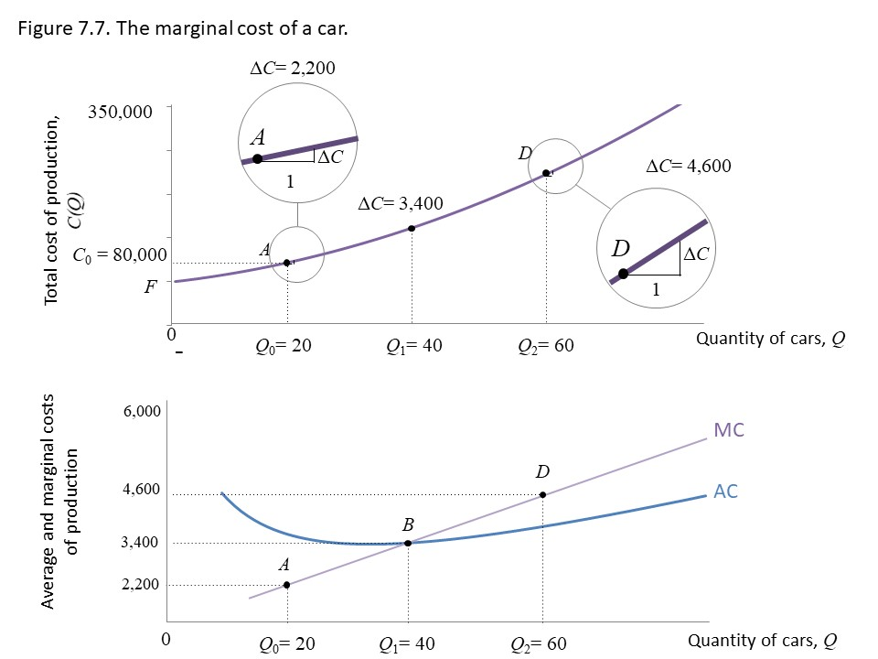
Depicting the Cost Curves

Slide 55
The MC also corresponds to the slope of the (TC) cost function
Marginal Cost

Slide 56
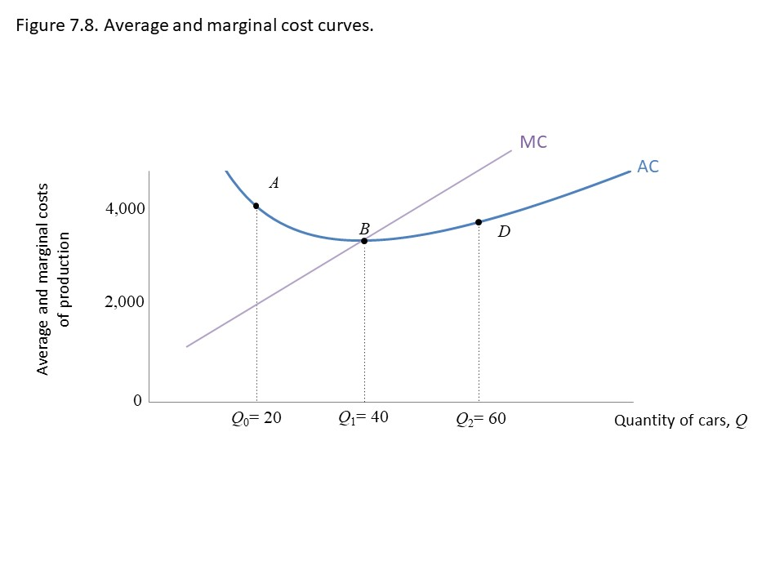
Depicting the Cost Curves
If MC < AC, AC is falling
If MC > AC, AC is rising
If MC=AC, AC has flat slope

Slide 57
7.4 Demand and Isoprofit Curves
04.

Slide 58
Demand Curve
A demand curve lines up consumers in order of their Willingness to Pay.
A demand curve is in a way, a set of ordered disagreements about the value of a good.
The willingness to pay (WTP) indicates how much a person values a good, measured by the maximum amount they would pay to acquire the good.

Slide 59
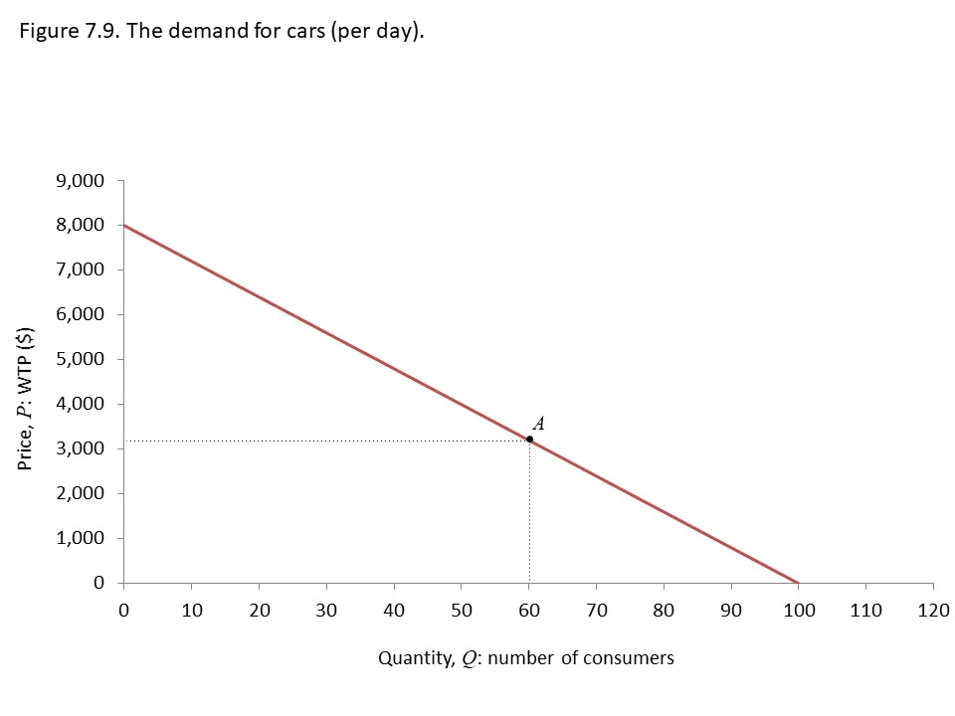
Differentiated Products
Products that are differentiated face downward sloping demand curves.
Suppose the Car Firm has the followinng demand curve.

Slide 60
Law of Demand
Davenant-King Law of Demand was published in 1699.
It showed that the price of corn changes with the size of the harvest.
Example: a 10% fall in corn output would raise prices by 30%.
The quantity demanded by consumers increases as the price falls (and decreases when the price rises), all other things being equal.

Slide 61
Economic Profit
Profit = TR – TC
  = PQ –C(Q)
  The cost function is no longer constant unit cost.
The owners of the capital must get a return high enough maintain their investment.
This is called normal profit.
  Corresponds to zero economic profit and means the rate of profit is equal to the opportunity cost of capital.
The economic profit is the firm’s revenue minus its total costs (including the opportunity cost of capital).

Slide 62

Grapes or Oranges?
My Uncle in Gisborne, decided to switch from growing grapes to growing oranges.
Prices of grapes were much higher than oranges.
So why did he decide to switch?

Slide 63
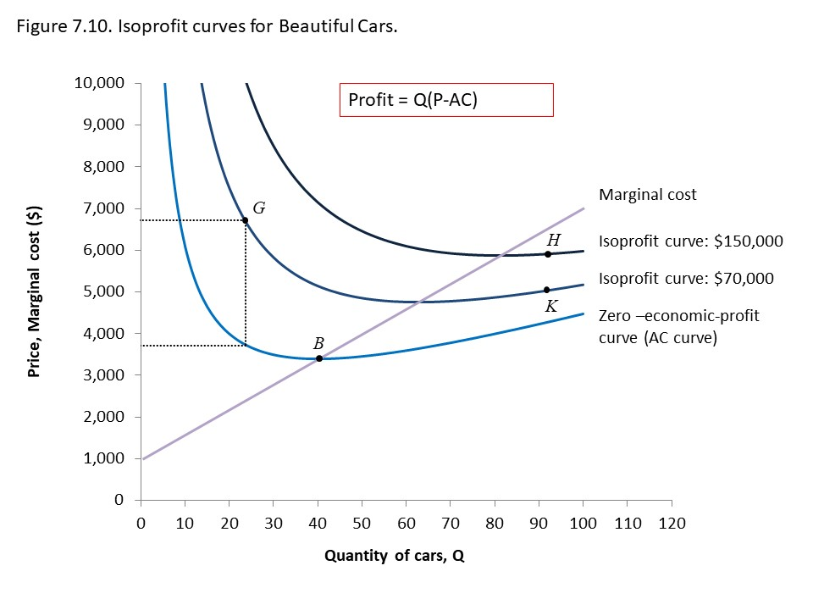
Isoprofit Curves
These depict the economic profit
The AC and MC cross at B when AC is the lowest
H is more profitable than K
Profit at G is 23 x $(6820-3777)

Slide 64
Notes
Isoprofit curves slope downward at points where P > MC
Isoprofit curves slope upward at points where P < MC
The difference between the price and marginal cost is called the profit margin.

Slide 65
7.5 Maximizing Profit
05.

Slide 66
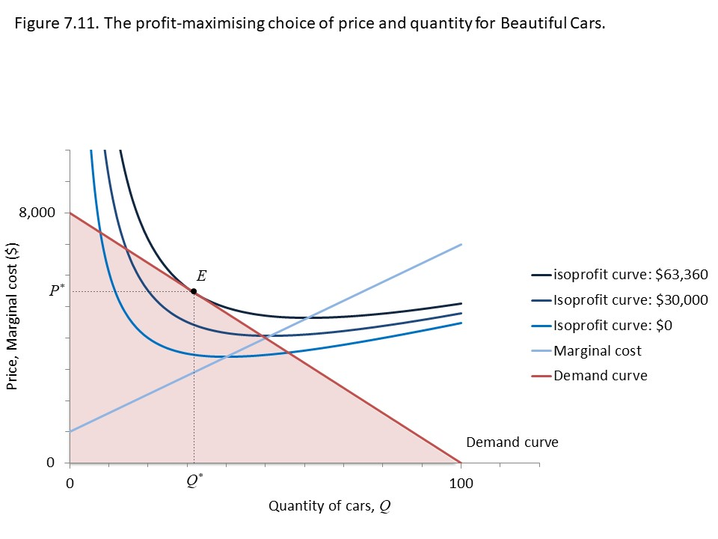
Solution
By producing at E the firm maximises profit
This corresponds P*=$5440 and Q* = 32.
Profit is $63,360

Slide 67
7.6 Profit Maximization
06.
Using Marginal Revenue and Marginal Cost

Slide 68
Alternative Method
We can use the Marginal Revenue function to find the Profit Maximising point.
Marginal Revenue (MR) is the
Change in Total Revenue caused by
A change in sales by one unit.

Slide 69
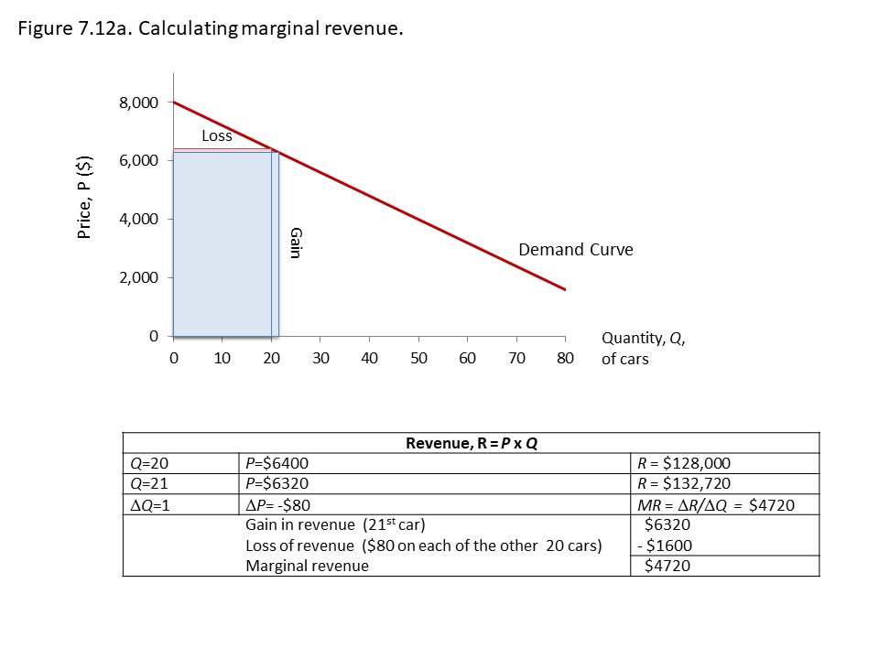
Calculating MR
Total Revenue is PQ
Increasing quantity sold has two effects on revenue
It increases because you sell more
It decreases because prices fall for all units sold

Slide 70
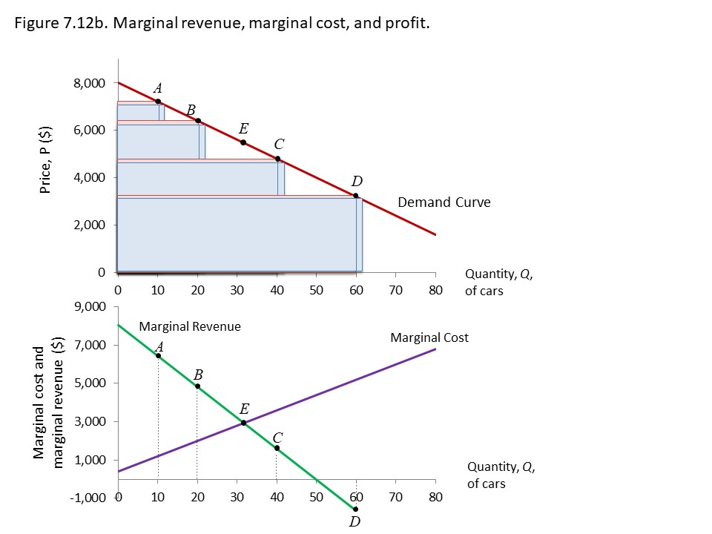
Calculating MR
MR equals MC at point E (Q* = 32), the profit maximising point.
At quantities below E, the firm gives up profit
At quantities above E, each unit reduces total profit.

Slide 71
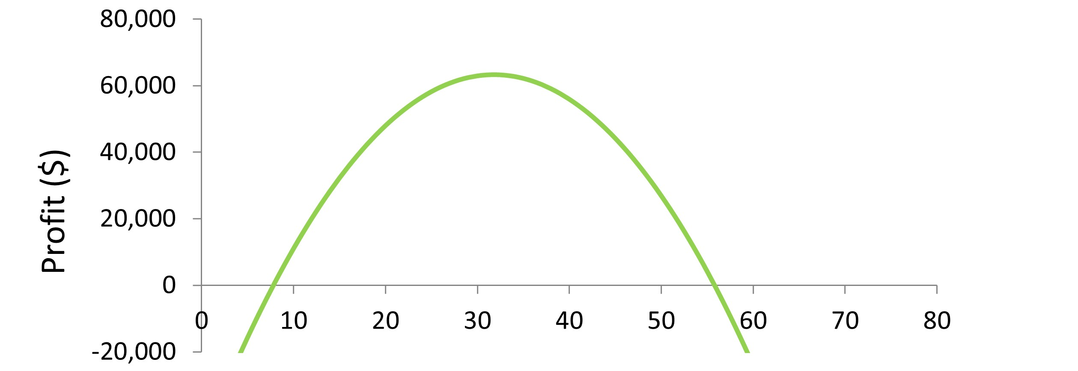
Depicting Profit
MR equals MC at point E, the profit maximising point.
At quantities below E, the firm gives up profit
At quantities above E, each unit reduces total profit.

Slide 72
Problem
P ($) | Q | TR ($) | TC ($)
100 | 1 | 100 | 200
90 | 2 | 180 | 220
80 | 3 | 240 | 230
70 | 4 | 280 | 270
60 | 5 | 300 | 310
50 | 6 | 300 | 360
40 | 7 | 280 | 410
30 | 8 | 240 | 470
20 | 9 | 180 | 540
What is the profit-maximizing level of output for this firm?

